Slide 1
Amazon sales data analysis
Some Business insights based on Revenue and Product analysis, Customer behavior and Branch performance

Slide 2





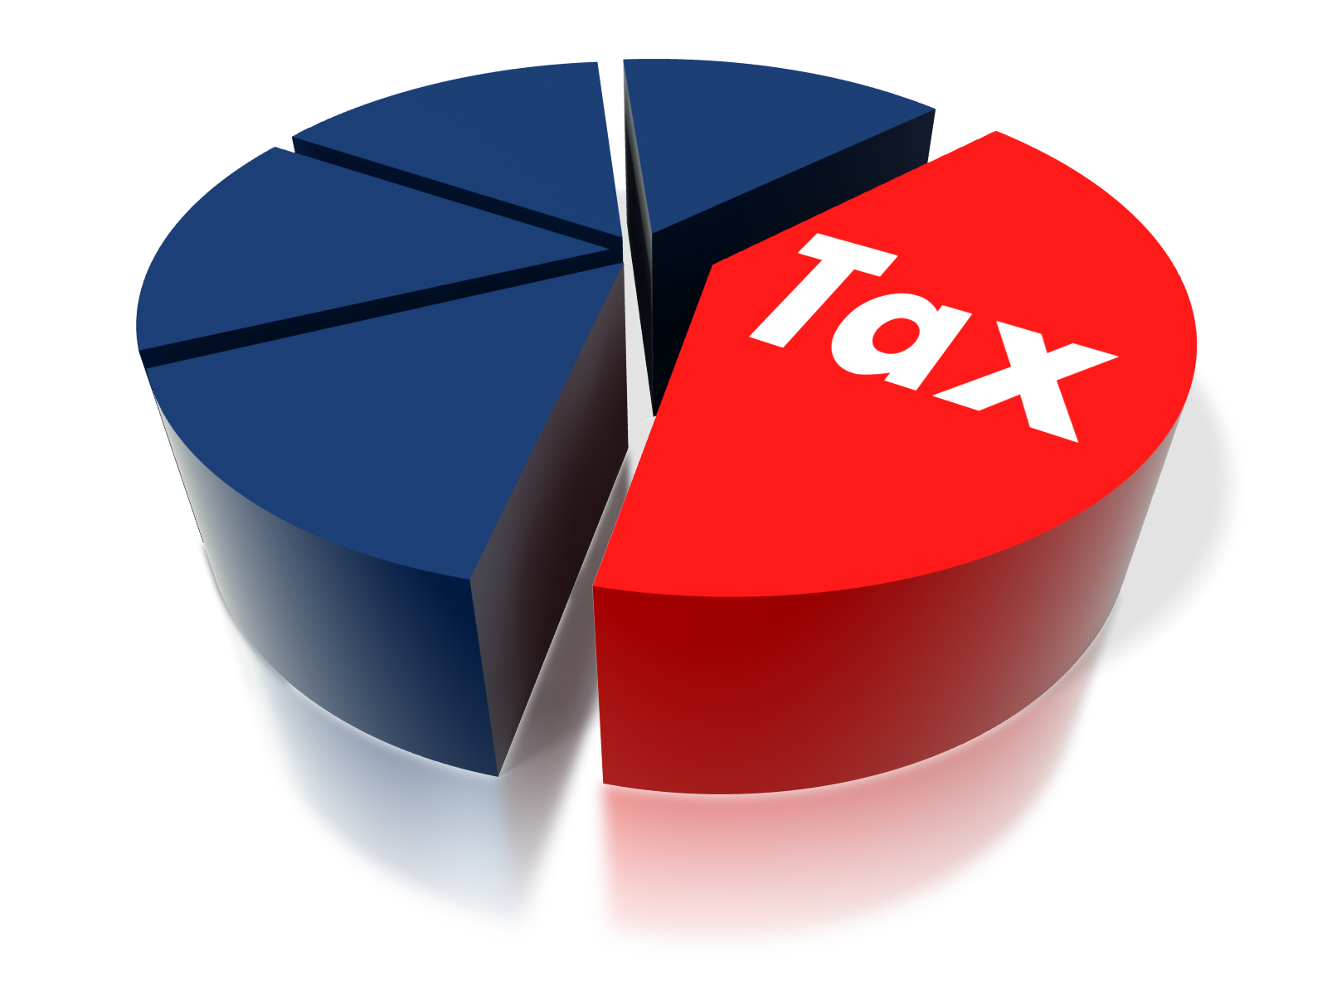
Transaction
1000
Quantity Sold
5510
Total Revenue
3,22,967
Average Tax
15%
Average Rating
7*
This Photo by Unknown Author is licensed under CC BY-SA
This Photo by Unknown Author is licensed under CC BY-NC

Slide 3
1.
Product_line | Total_ordered
Electronic accessories | 971
Food and beverages | 952
Sports and travel | 920
Home and lifestyle | 911
Fashion accessories | 902
Health and beauty | 854
2.
Product_line | Total_revenue
Food and beverages | 56145
Sports and travel | 55123
Electronic accessories | 54338
Fashion accessories | 54306
Home and lifestyle | 53862
Health and beauty | 49194

Slide 4
3.
Monthname | Total_revenue
January | 116292
March | 109456
February | 97220
4.
Gender | Product_line | Total_ordered
Female | Fashion accessories | 530
Female | Food and beverages | 514
Male | Health and beauty | 511
Female | Home and lifestyle | 498
Female | Sports and travel | 496
Female | Electronic accessories | 488
Male | Electronic accessories | 483
Male | Food and beverages | 438
Male | Sports and travel | 424
Male | Home and lifestyle | 413
Male | Fashion accessories | 372
Female | Health and beauty | 343

Slide 5
5.
Branch | City | Total_revenue
C | Naypyitaw | 110569
A | Yangon | 106201
B | Mandalay | 106198
6.
Product_line | Avg_rating
Food and beverages | 7.1
Health and beauty | 7
Fashion accessories | 7
Electronic accessories | 6.9
Sports and travel | 6.9
Home and lifestyle | 6.8

Slide 6
7.
Payment | Number_of_transaction
Ewallet | 345
Cash | 344
Credit card | 311
8.
customer_type | Gender | No_of_purchase
Member | Female | 261
Member | Male | 240
Normal | Female | 240
Normal | Male | 259

Slide 7
9.
Day_name | Total_order
Saturday | 164
Tuesday | 158
Wednesday | 143
Friday | 139
Thursday | 138
Sunday | 133
Monday | 125
10.
Time_of_day | Number_of_order
Evening | 433
Morning | 294
Afternoon | 273

Slide 8
11.
Customer_rating | Rating_status
Good | 481
Averege | 341
Poor | 178

